Slide 1
Lecture #16 :
Inheritance – Extending classes (contd...)
COMP 116: Object Oriented Programming
Presented by:
Roshan Manjushree Adhikari
Kathmandu University
2nd July, 2018

Slide 2
Abstract class
Cannot instantiate an object.
Sometimes implementation of all function cannot be provided in a base class because we don’t know the implementation.
Just acts as a base class (to be inherited by other class).
One or more methods are declared but not defined.
All derived class of abstract class should compulsorily implement the method.
A class that is not abstract is called concrete class.

Slide 3
Abstract class (contd...)
A pure virtual function (or abstract function) in C++ is a virtual function for which we don’t have implementation, we only declare it.
A pure virtual function is declared by assigning 0 in declaration.
A class is abstract if it has at least one pure virtual function.
We can have pointers and references of abstract class type.
If we do not override the pure virtual function in derived class, then derived class also becomes abstract class.
An abstract class can have constructors.
An abstract class can have function with body.

Slide 4
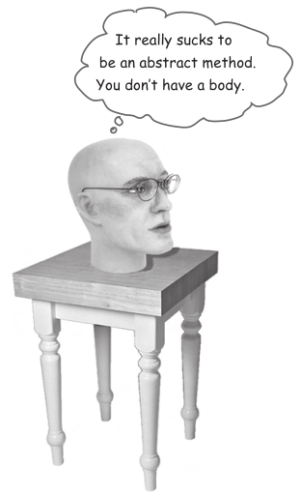
You MUST implement all abstract methods

Slide 5
Animal
abstract
abstract
Canine
abstract
Hippo
Feline
Cat
Wolf
Lion
Dog
Tiger

Slide 6
How do you know when a class should be abstract ?

Slide 7
Constructors in derived class
Base class constructors are always called in the derived class constructors.
Whenever you create derived class object, first the base class default constructor is executed and then the derived class's constructor finishes execution.
In case of multiple inheritance, the base classes are constructed in the order in which they appear in the declaration of the derived class. (similar in multilevel)

Slide 8
Constructors in derived class (contd...)
Whether derived class's default constructor is called or parameterised is called, base class's default constructor is always called inside them.
To call base class's parameterised constructor inside derived class's parameterised constructor, we must mention it explicitly while declaring derived class's parameterized constructor.

Slide 9
Class A
A()
What will happen ??? Which constructor will be called ??
public
Class B
B()
: A()
B obj;

Slide 10
Advantages of Inheritance
Provides reusability. Existing classes remain unchanged. So, the development time of software is reduced.
You can avoid is code duplication. How ?????
Define a common protocol for a group of classes.
Makes the application code more flexible to change.
Derived class can extend the properties of base class to generate more dominanant objects.
Data hiding : Base class can decide to keep some data private so that it cannot be altered by the derived class.
You can extend the “Bad” class and override the method with your own better code......

Slide 11
Important !!!
Assignment #4 and Lab #6
Deadline : 9th July, 2018

